Slide 1
Anatomical Terminology Practice Exam #2

Slide 2
*For best results on these practice exams, write your answers on paper before clicking to see the correct answer and make sure to check your spelling!
Using proper anatomical terminology, name the following body regions and landmarks:

Slide 3
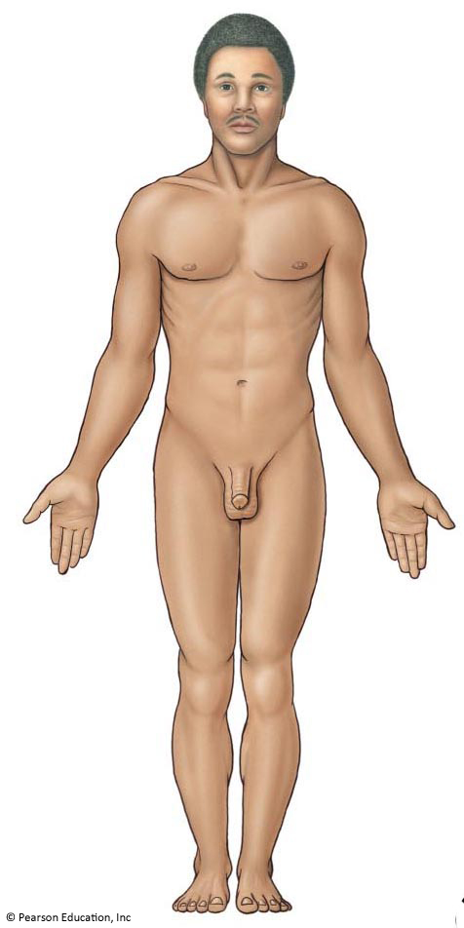
1
*click to the next slide to check your answer

Slide 4
Cephalic (cephalon)

Slide 5
2
*click to the next slide to check your answer

Slide 6
Oral (oris)

Slide 7
3
*click to the next slide to check your answer

Slide 8
Abdominal (abdomen)

Slide 9
4
*click to the next slide to check your answer

Slide 10
Acromial (acromion)

Slide 11
5
*click to the next slide to check your answer

Slide 12
Umbilical (umbilicus)

Slide 13
6
*click to the next slide to check your answer

Slide 14
Sternal (sternum)

Slide 15
7
*click to the next slide to check your answer

Slide 16
Pollicis (pollex)

Slide 17
8
*click to the next slide to check your answer

Slide 18
Carpal (carpus)

Slide 19
9
*click to the next slide to check your answer

Slide 20
Tarsal (tarsus)

Slide 21
10
*click to the next slide to check your answer

Slide 22
Crural (crus/crura)

Slide 23
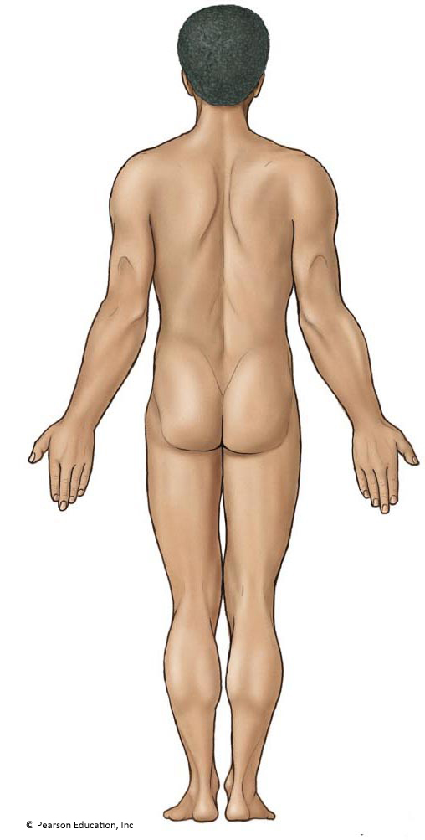
11
*click to the next slide to check your answer

Slide 24
Gluteal (gluteus)

Slide 25
12
*click to the next slide to check your answer

Slide 26
Olecranal (olecranon)

Slide 27
13
*click to the next slide to check your answer

Slide 28
Sural (sura)

Slide 29
14
*click to the next slide to check your answer

Slide 30
Calcaneal (calcaneus)

Slide 31
15
*click to the next slide to check your answer

Slide 32
Antecubital (antecubitus)

