Slide 1
Bone
Practice Exam #2

Slide 2
Name the following structures indicated by the arrows.
Click to the next slide to see the answer.
*For best results on these practice exams, write your answers on paper before clicking to see the correct answer. Try to answer within a minute (remember your lab exams will be timed) and make sure to check your spelling!
*note: not every structure you are required to know will be on this practice exercise so make sure you review the checklist of structures (p. 74-75 in your lab manual) when preparing for your lab exam

Slide 3
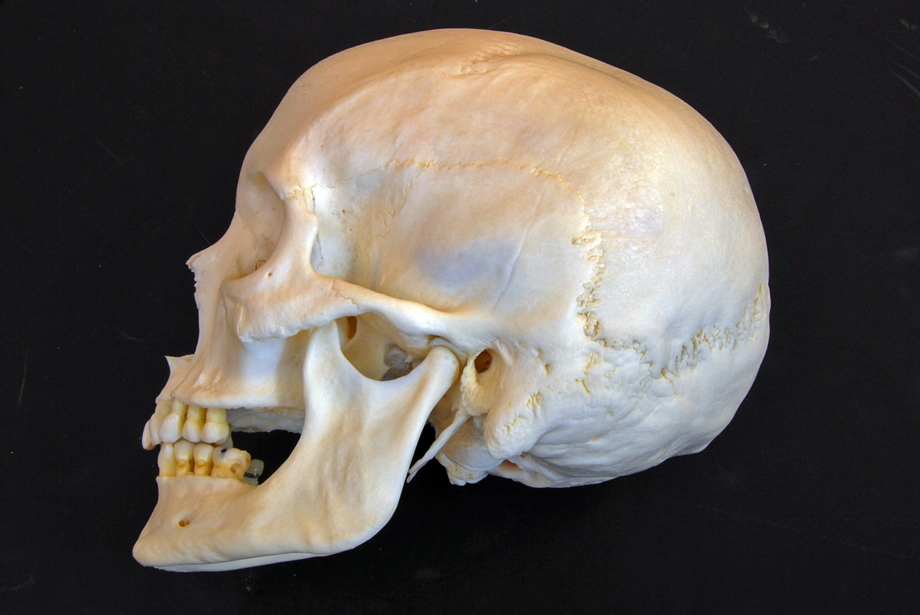
*click to the next slide to check your answer

Slide 4
Lambdoid suture

Slide 5
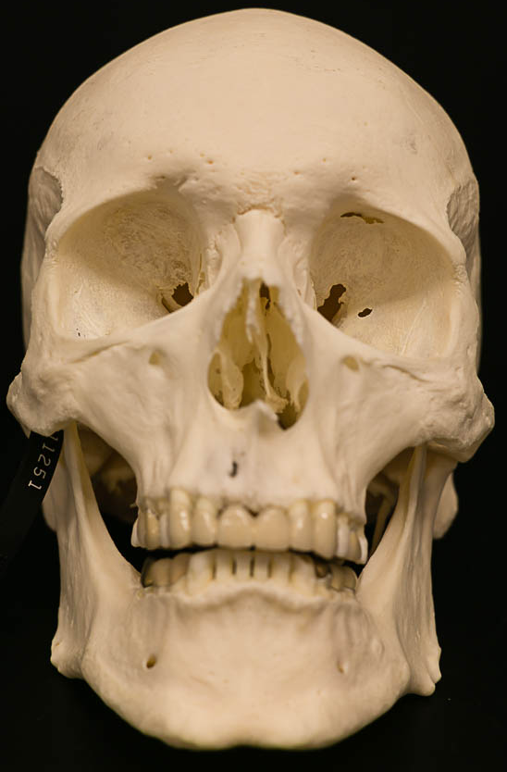
*click to the next slide to check your answer

Slide 6
Supraorbital margin of frontal bone

Slide 7
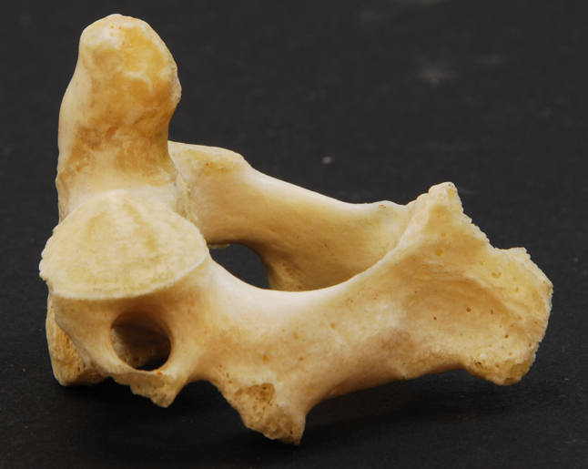
*click to the next slide to check your answer

Slide 8
Superior articular facet of C2

Slide 9
*click to the next slide to check your answer

Slide 10
Vomer

Slide 11
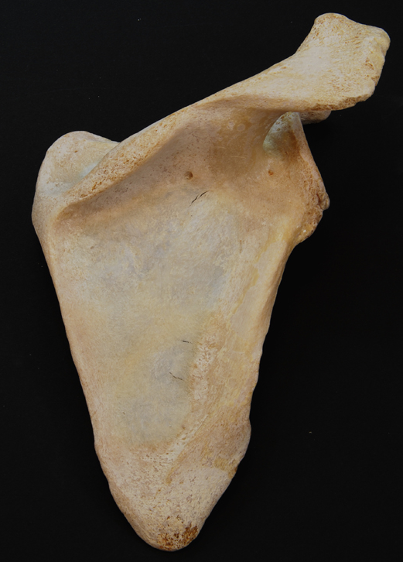
*click to the next slide to check your answer

Slide 12
Glenoid fossa (cavity) of the scapula

Slide 13
*click to the next slide to check your answer

Slide 14
Zygomatic bone

Slide 15
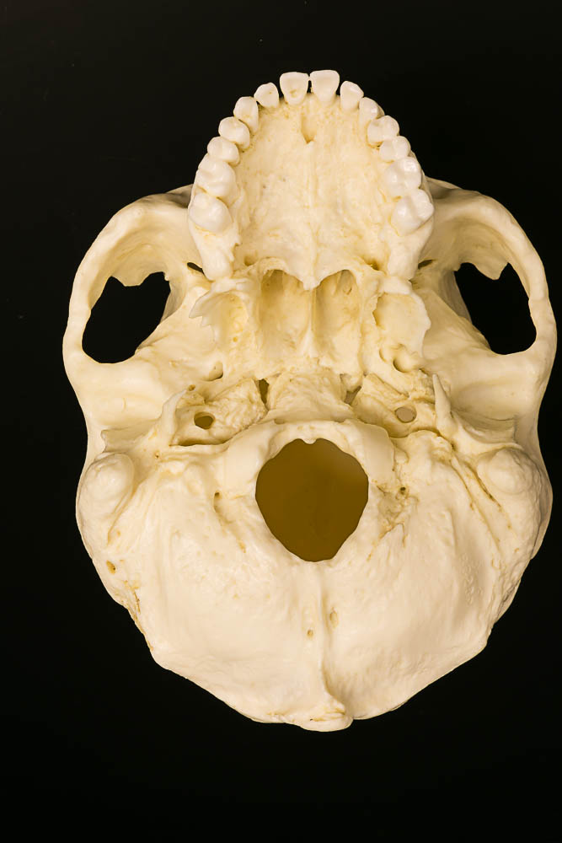
*click to the next slide to check your answer

Slide 16
Palatine bone

Slide 17
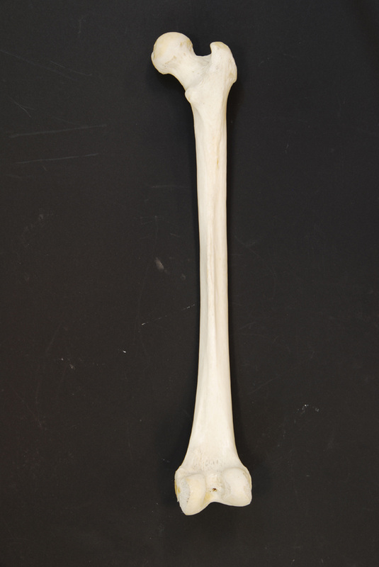
*click to the next slide to check your answer

Slide 18
Head of femur

Slide 19
*click to the next slide to check your answer

Slide 20
Foramen magnum of occipital bone

Slide 21
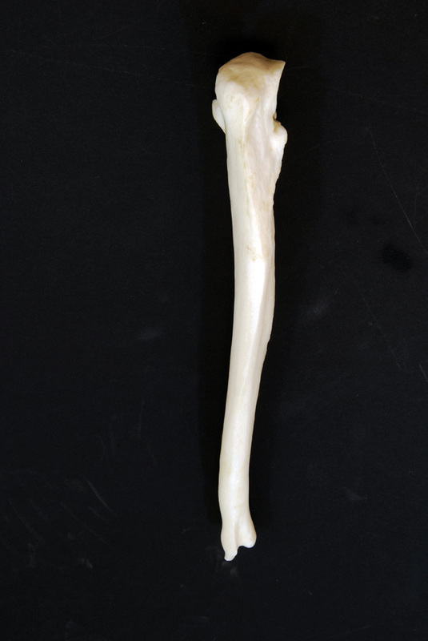
*click to the next slide to check your answer

Slide 22
Styloid process of ulna

Slide 23
*click to the next slide to check your answer

Slide 24
Mandibular fossa of the temporal bone

Slide 25
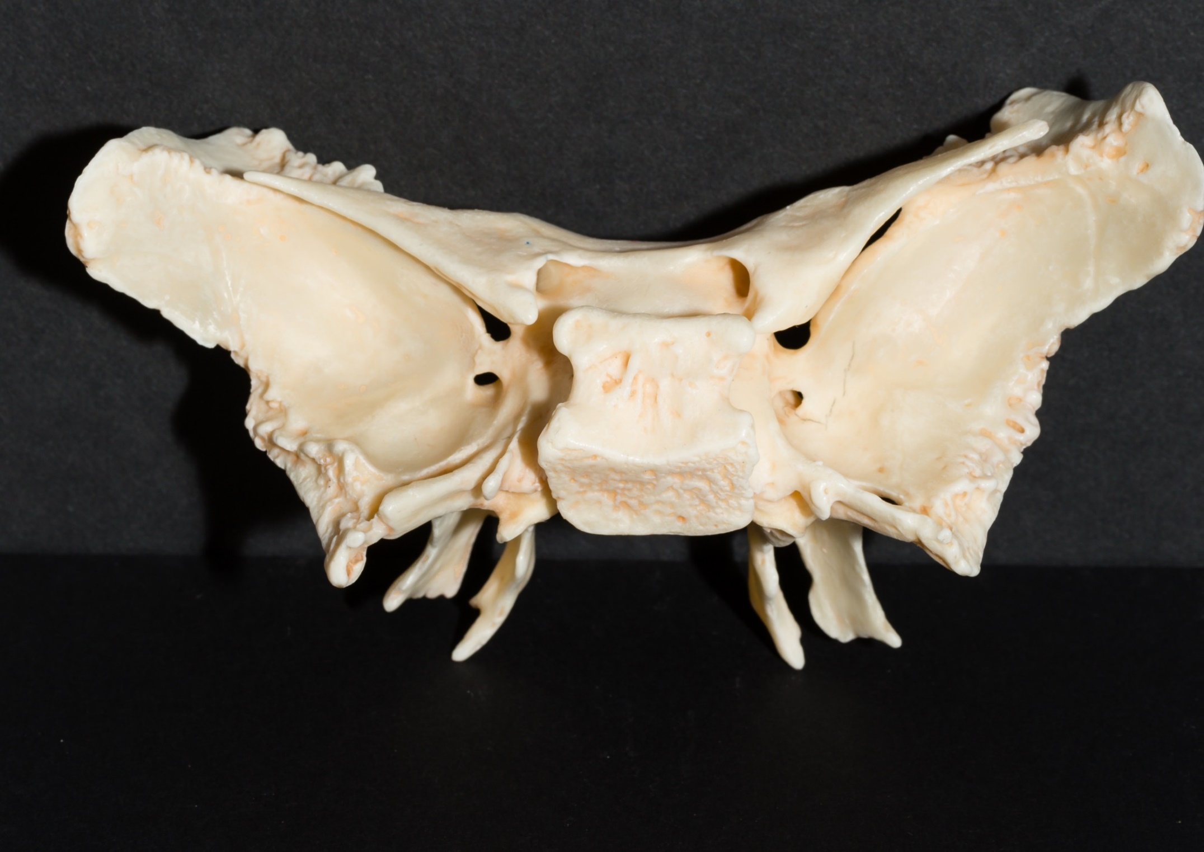
*click to the next slide to check your answer

Slide 26
Optic foramen of the sphenoid

Slide 27
*click to the next slide to check your answer

Slide 28
Infraspinous fossa of the scapula

Slide 29
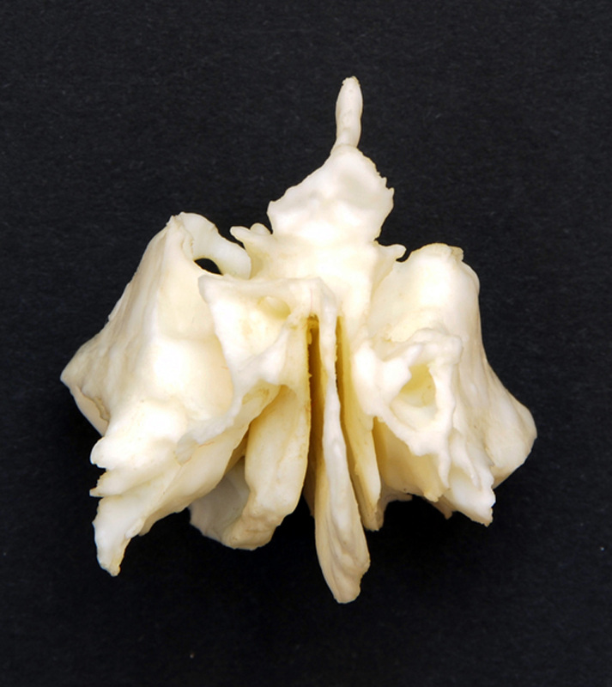
*click to the next slide to check your answer

Slide 30
Perpendicular plate of ethmoid

Slide 31
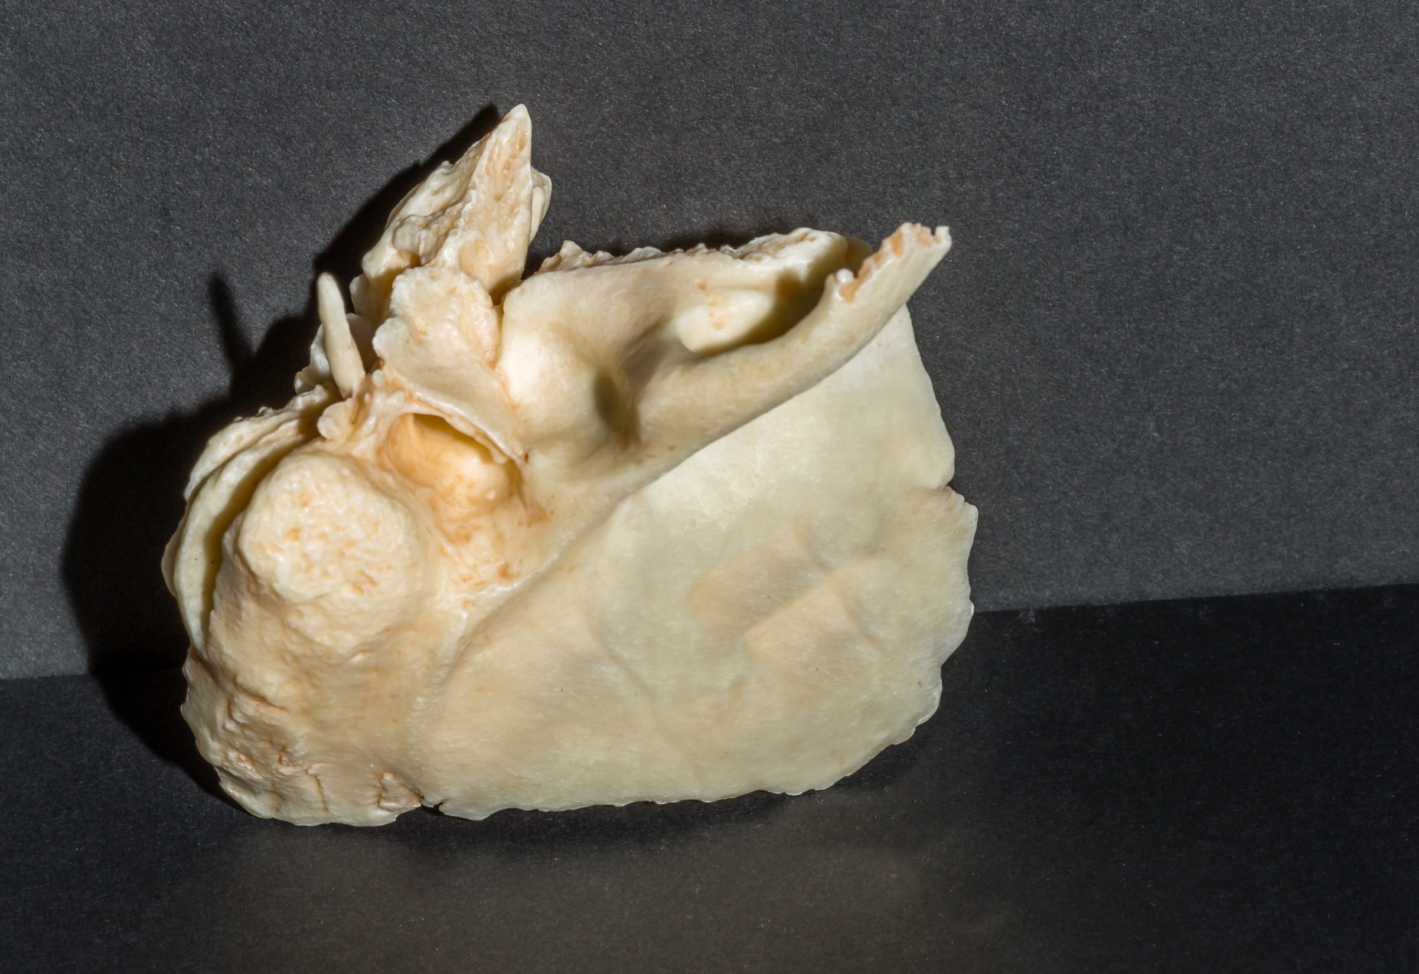
*click to the next slide to check your answer

Slide 32
Mastoid process of temporal bone

Slide 33
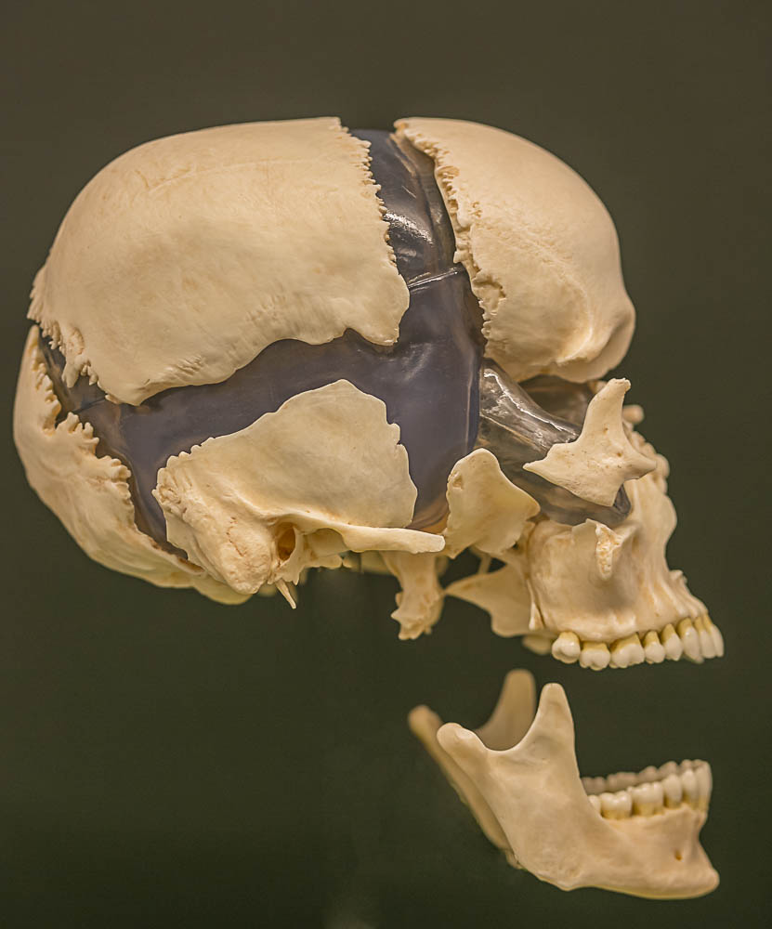
*click to the next slide to check your answer

Slide 34
Frontal bone

Slide 35
*click to the next slide to check your answer

Slide 36
Occipital bone

Slide 37
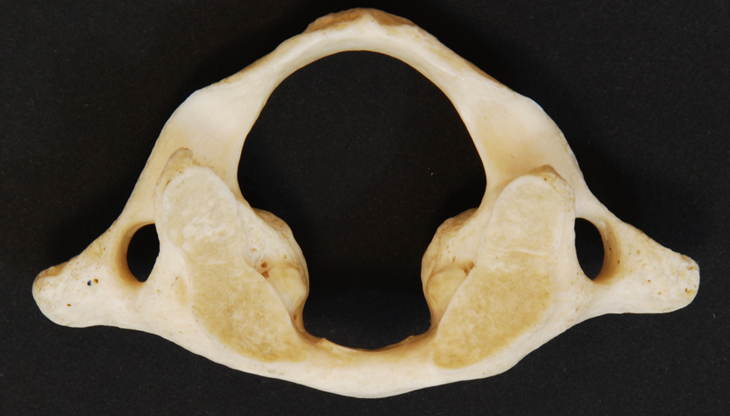
*click to the next slide to check your answer

Slide 38
Transverse foramen of C1

Slide 39
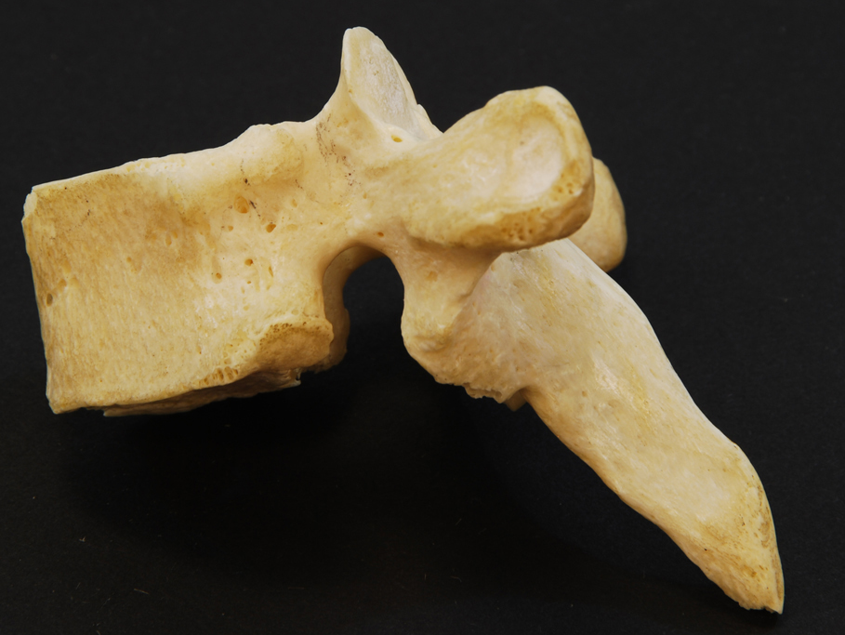
*click to the next slide to check your answer

Slide 40
Transverse costal facet of thoracic

Slide 41
*click to the next slide to check your answer

Slide 42
Mandibular condyle

Slide 43
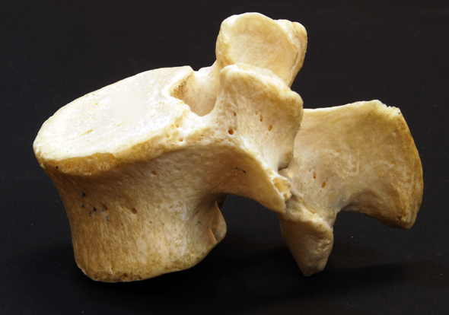
*click to the next slide to check your answer

Slide 44
Pedicle of lumbar vertebra

Slide 45
*click to the next slide to check your answer

Slide 46
Median sacral crest

Slide 47
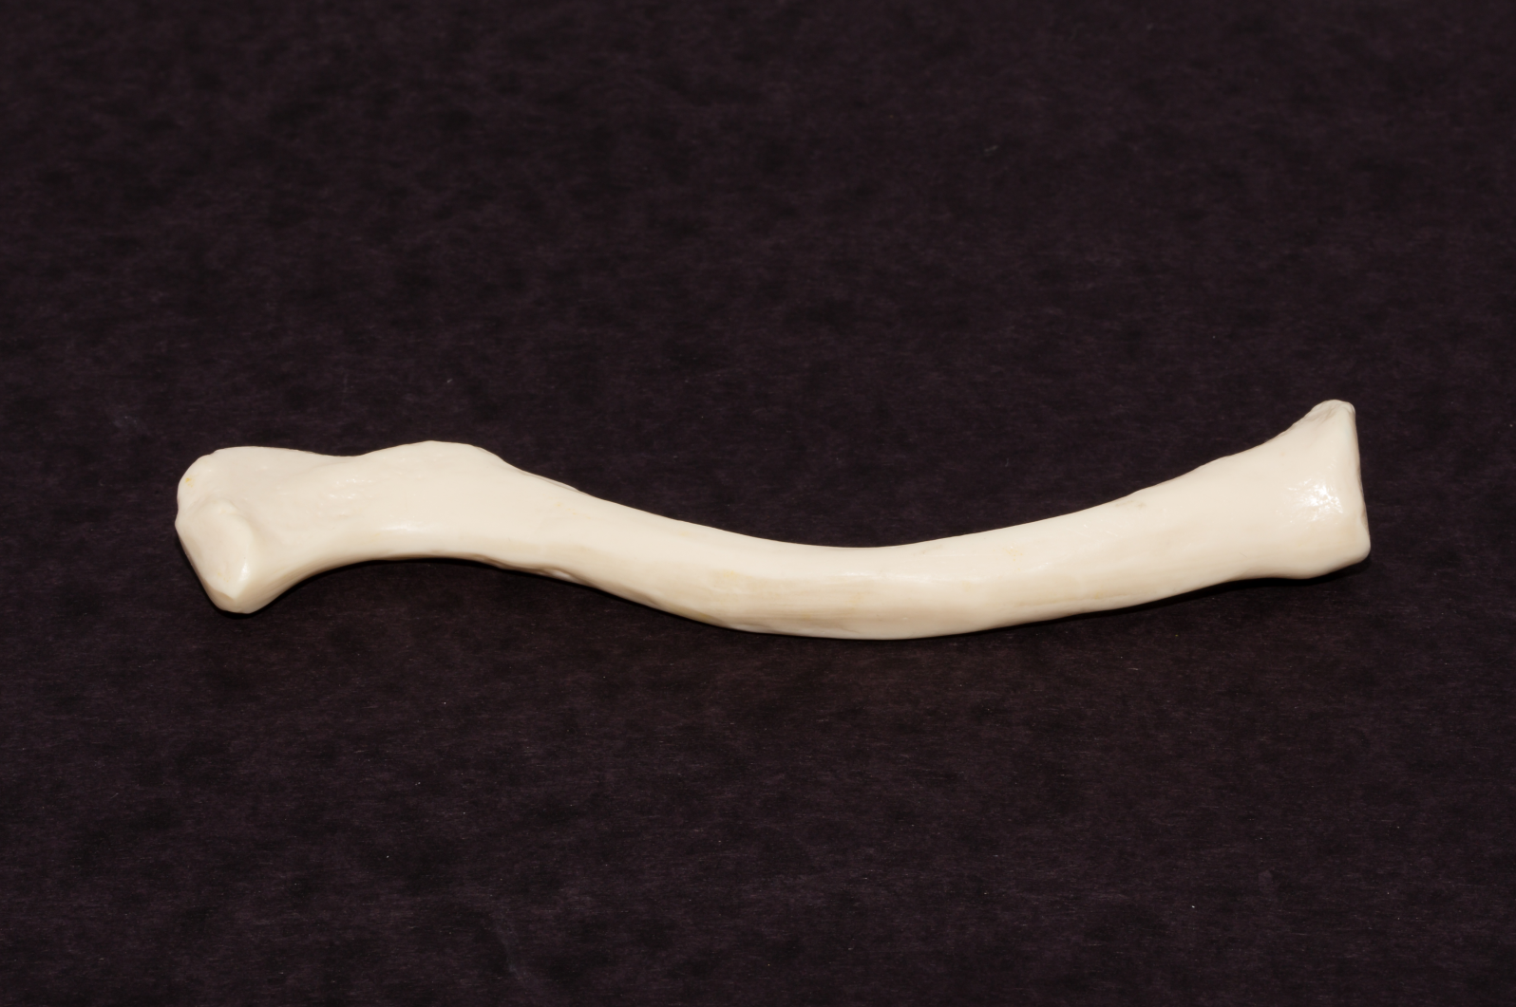
*click to the next slide to check your answer

Slide 48
Sternal end of clavicle

Slide 49
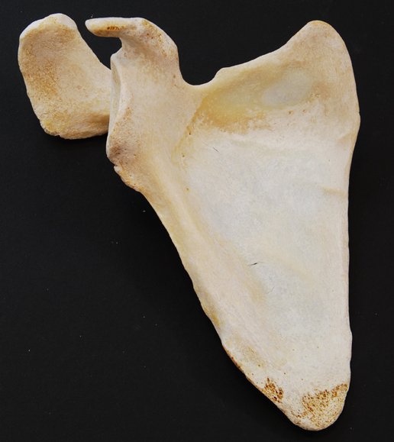
*click to the next slide to check your answer

Slide 50
Acromion (acromial process) of the scapula

Slide 51
*click to the next slide to check your answer

Slide 52
Head of humerus

Slide 53
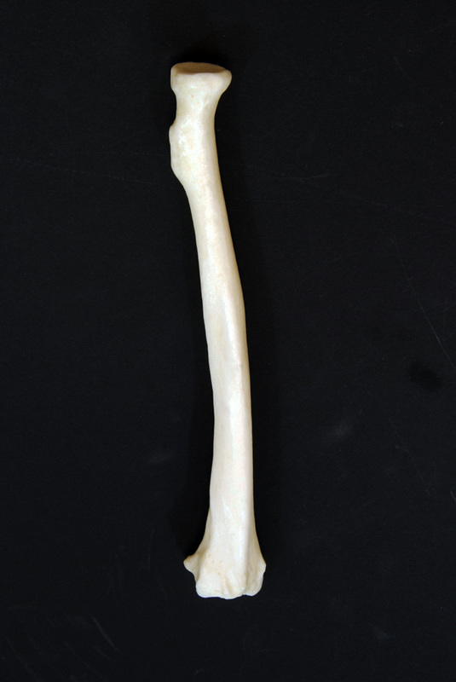
*click to the next slide to check your answer

Slide 54
Ulna notch of radius

Slide 55
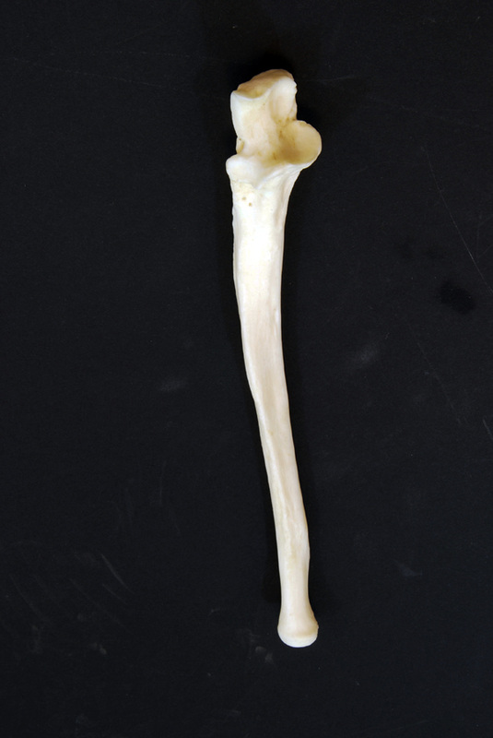
*click to the next slide to check your answer

Slide 56
Trochlear notch of ulna

Slide 57
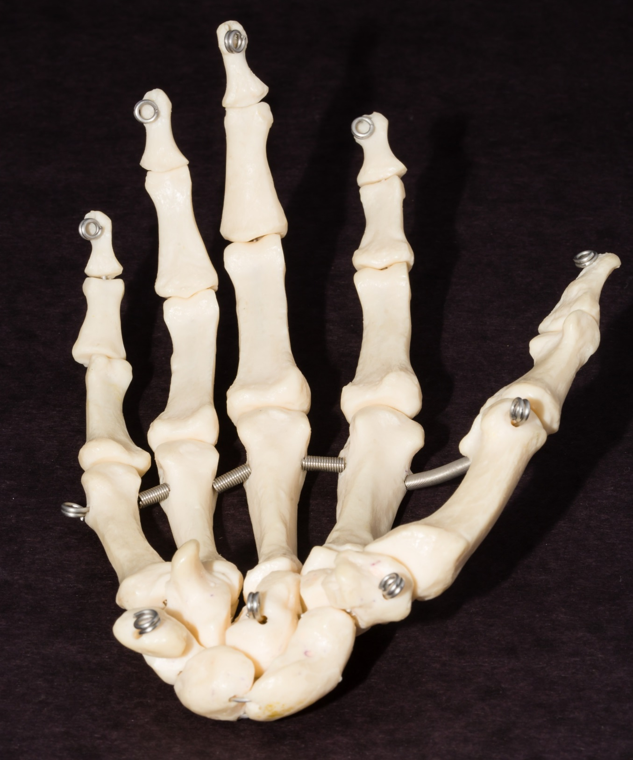
*click to the next slide to check your answer

Slide 58
Lunate

Slide 59
*click to the next slide to check your answer

Slide 60
Hamate

Slide 61
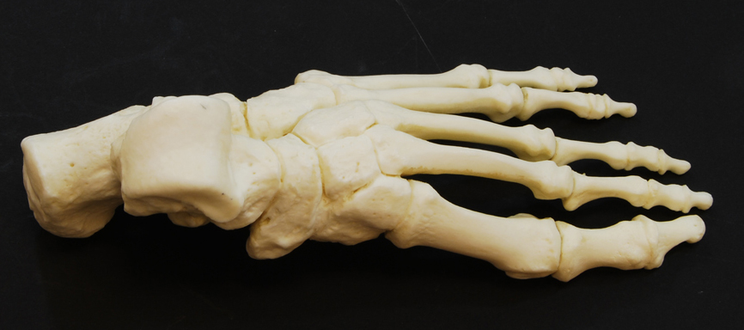
*click to the next slide to check your answer

Slide 62
Base of metatarsal I

Slide 63
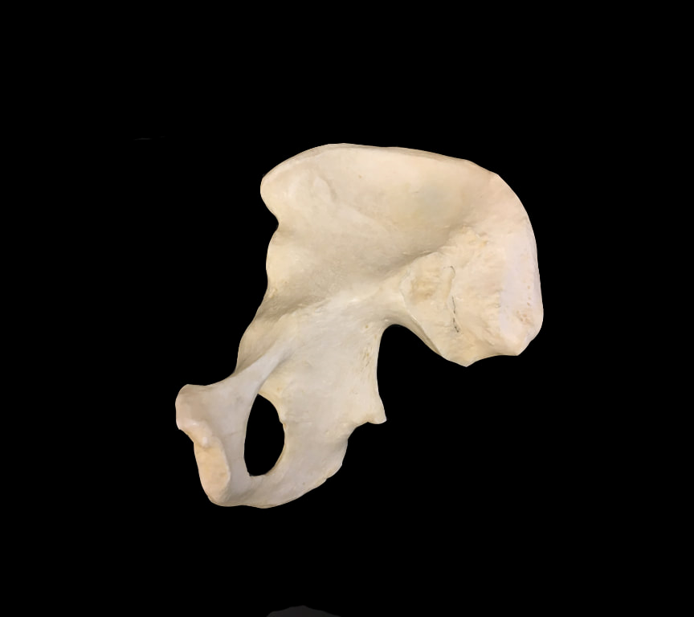
*click to the next slide to check your answer

Slide 64
Iliac fossa

Slide 65
*click to the next slide to check your answer

Slide 66
Greater sciatic notch of ilium

Slide 67
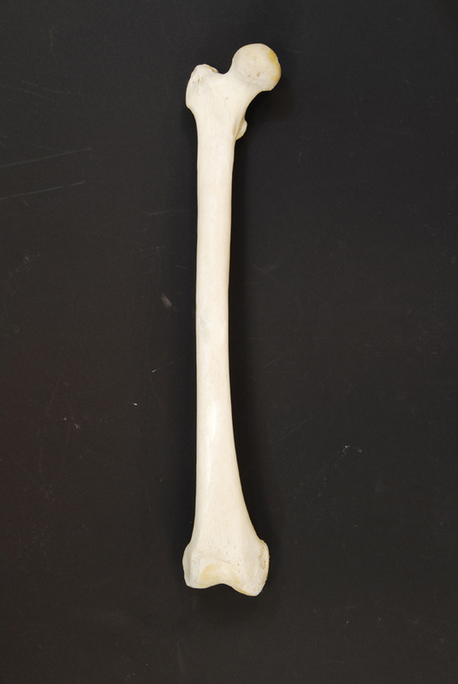
*click to the next slide to check your answer

Slide 68
Lesser trochanter of femur

Slide 69
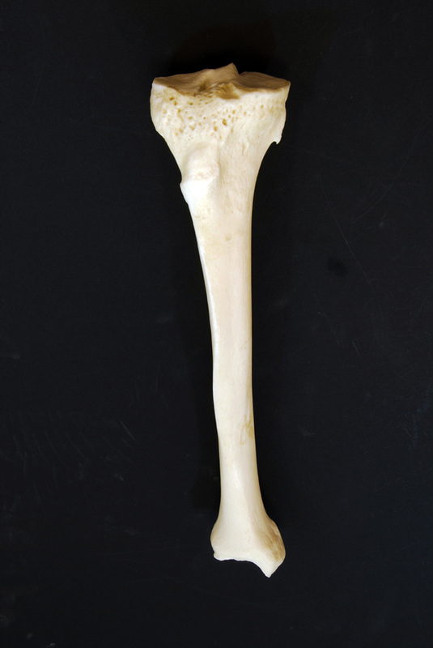
*click to the next slide to check your answer

Slide 70
Medial malleolus of tibia

Slide 71
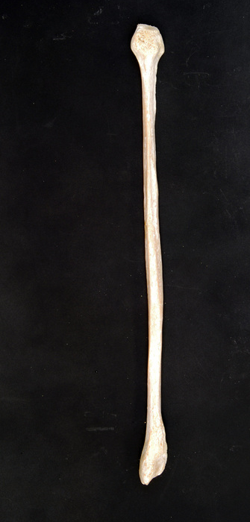

Slide 72
Head of fibula

Slide 73
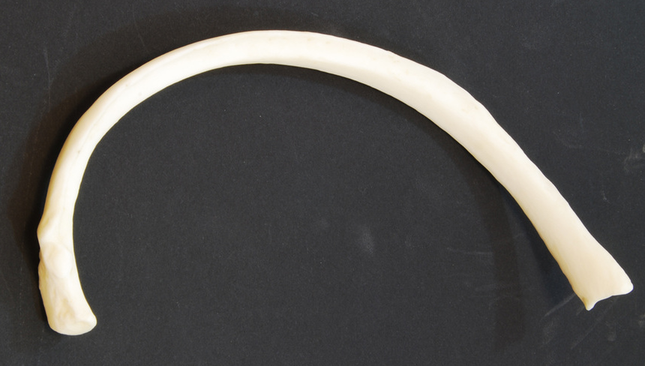
*click to the next slide to check your answer

Slide 74
Tubercle of rib

Slide 75
*click to the next slide to check your answer

Slide 76
Vertebral body of typical cervical vertebra

Slide 77
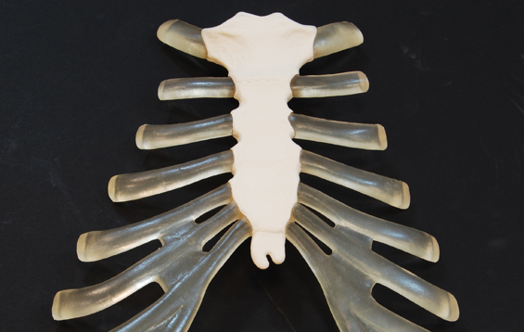
*click to the next slide to check your answer

Slide 78
Manubrium of sternum

Slide 79
*click to the next slide to check your answer

Slide 80
Calcaneus

Slide 81
*click to the next slide to check your answer

Slide 82
Middle phalanx of digit IV (Rt. upper extremity)

Slide 83
*click to the next slide to check your answer

Slide 84
Olecranon fossa of humerus

Slide 85
*click to the next slide to check your answer

Slide 86
Posterior superior iliac spine

