Slide 1
Directional Terminology
Name the following anatomical directional terms as indicated by the arrows:

Slide 2
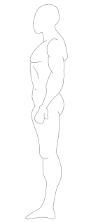
*click to the next slide to check your answer

Slide 3
Anterior/Ventral

Slide 4
*click to the next slide to check your answer

Slide 5
Posterior/Dorsal

Slide 6
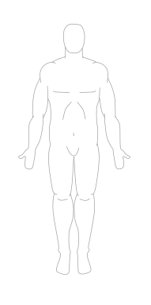
*click to the next slide to check your answer

Slide 7
Superior (cranial/cephalic)

Slide 8
*click to the next slide to check your answer

Slide 9
Inferior (caudal)

Slide 10
*click to the next slide to check your answer

Slide 11
Proximal

Slide 12
*click to the next slide to check your answer

Slide 13
Distal

Slide 14
*click to the next slide to check your answer

Slide 15
Medial

Slide 16
*click to the next slide to check your answer

Slide 17
Lateral

Slide 18
outside
outside
Inside
outside
outside
*click to the next slide to check your answer

Slide 19
Superficial/External

Slide 20
outside
outside
Inside
outside
outside
*click to the next slide to check your answer

Slide 21
Deep/Internal

